Slide 1
Lecture 12
Classes and structures, pt.4
Konstantin Leladze
OOP in C++
DIHT MIPT 2021

Slide 2
Splitting the solution into multiple files
C++ has a common project structure. For now, I'll just teach you how to split your solution into several files and organize the structure correctly without going into details.
Let's take the vector class we wrote in the previous lesson.
So far, our entire solution is written in one file - main.cpp. So far, this does not cause problems, since there is little code, but on an industrial scale, the amount of code in the repository can be several million lines of code, so it is important to be able to split the solution into separate components, and the files corresponding to them.
For example, our code now has three parts:
The double_cmp function, which compares doubles, separate from the vector class
The vector class, which is a vector in three-dimensional space, and the operators redefined to work with it
The main function

Slide 3
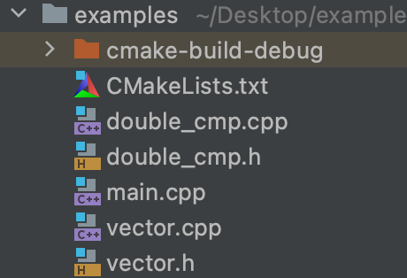
Splitting the solution into multiple files
Each component, which is, for example, a class (just like in our case) must have two files: .h and .cpp
In the .h files, we declare functions, classes and their methods, but we don't define them!
In the .cpp files, we define functions and methods of the class
Both files must have the same name, but have different extensions. The name of the files must coincide with the name of the class, if the component is a class, or, otherwise, when the component contains several classes, generalize their essence.
For example, our project can be divided into 2 components:
vector: will contain class vector
double_cmp: will contain function double_cmp
The project structure is shown on the right:

Slide 4
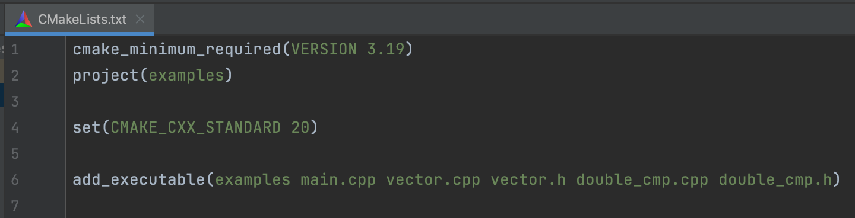
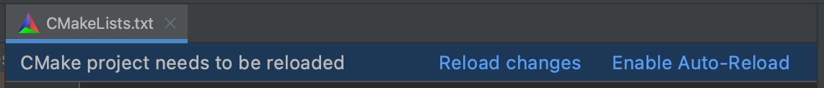
Splitting the solution into multiple files
After adding the files to the project, you will also have to add the file names to CMakeLists.txt
Also, if you are working in CLion, after changing CMakeLists, you will be prompted to reload project. Obviously, this must be done in order for the compiler to update the project structure.

Slide 5
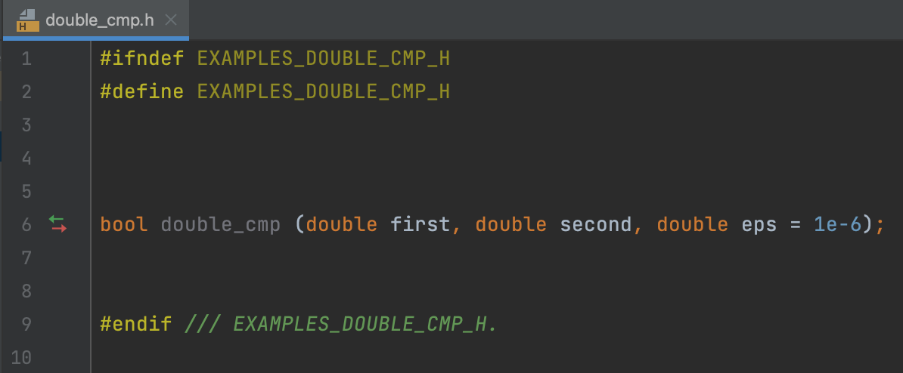
Splitting the solution into multiple files
In double_cmp.h file, we declare a function double_cmp.
Note that the arguments in the function declaration are not const-qualified, because const-qualifier is pointless for unmodified type in declarations. In other words, const qualifier of unmodified type (non-pointer, non-array and non-reference type) is only valid in definitions.
EXAMPLES_DOUBLE_CMP_H – is a “full name” of the file, which compiler will use in order to avoid including one file multiple times.
This name should be unique for every header file in your project.
Usually, this name is built according to the following principle: {project_name}_{path_to_file}.
For example, if my project is called geometry, and the file path is lib/figures/polygon.h, then define should be: GEOMETRY_LIB_FIGURES_POLYGON_H

Slide 6
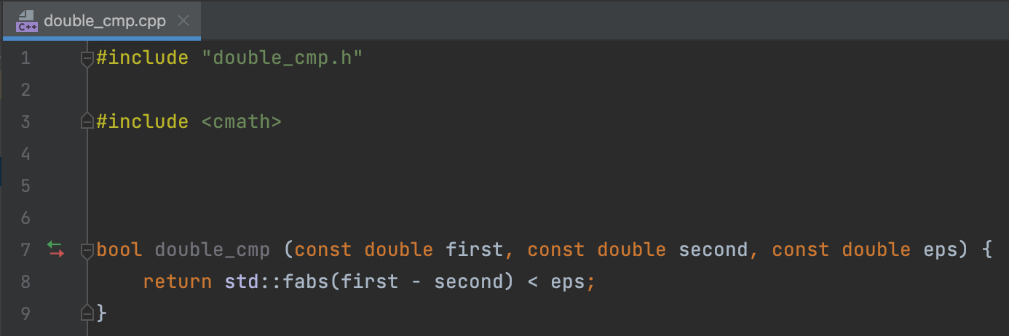
Splitting the solution into multiple files
In double_cmp.cpp file, we define a function double_cmp.
In the definition we add const-qualifier, but we do not assign the default value for the eps argument (default value should be assigned in the declaration)
It’s mandatory to include the corresponding header file in the source file.
But the opposite should never be done! In other words, never do an include of a .cpp file in your code!

Slide 7
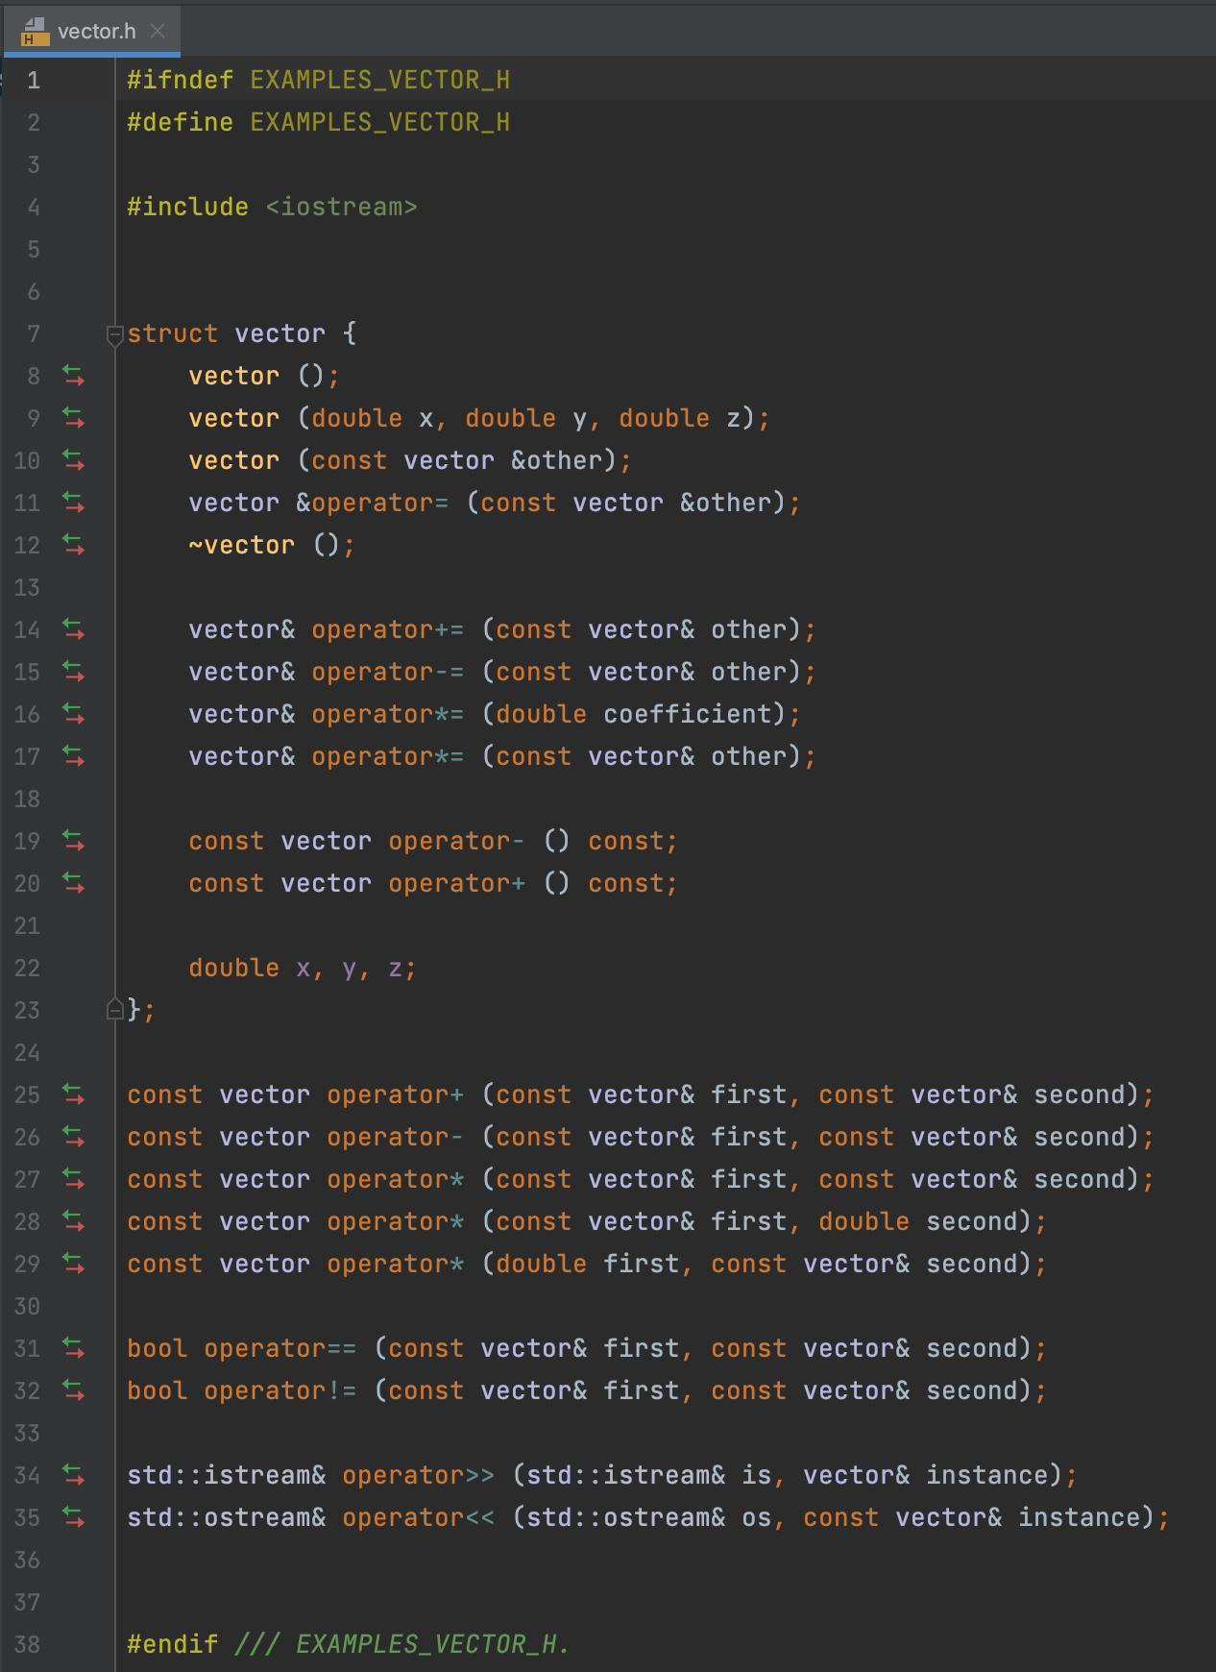
Splitting the solution into multiple files
In the vector.h file, we only provide function declarations, even if they are methods (defined inside the class)!
Also, don’t forget about #define
Once again, const qualifiers are absent in functions signatures for the arguments, provided by values

Slide 8
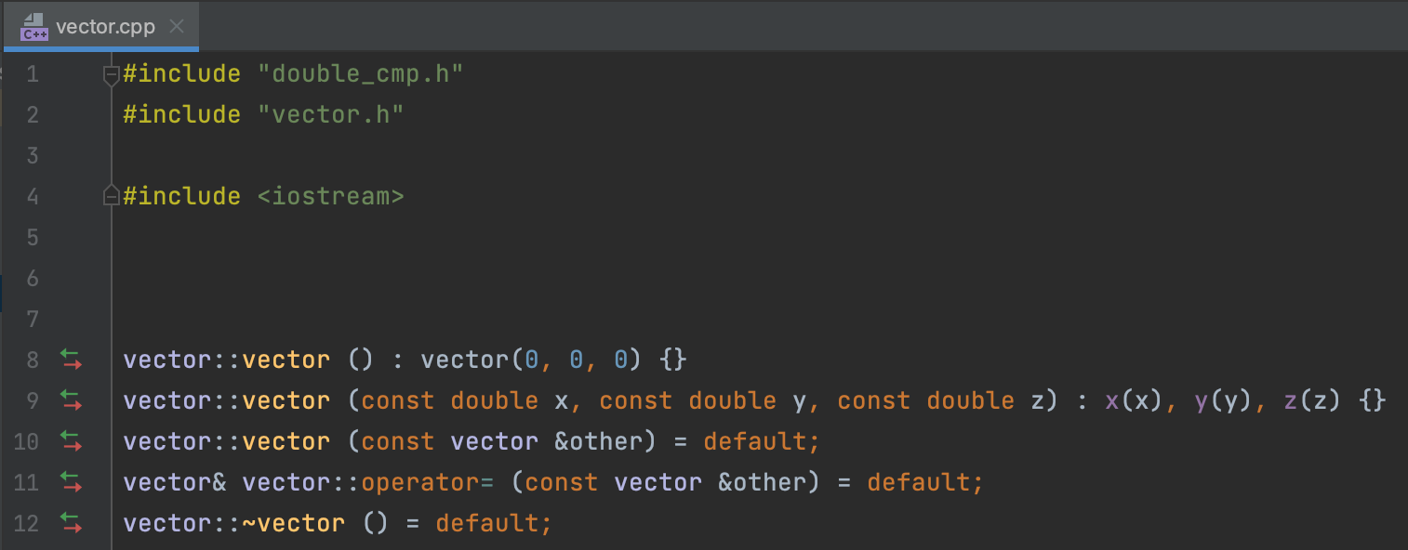
Splitting the solution into multiple files
In vector.cpp we define methods and functions which are declared in vector.h
Don't forget #include "vector.h”
Using the operator ::, we can define methods
For this, before the method name, you need to add the class name and the operator ::
In the case of non-method functions, we don't need to do this!
For example, if the class is called my_class, and the method in it is my_method, then its definition might look like this: void my_class::my_method () {}

Slide 9
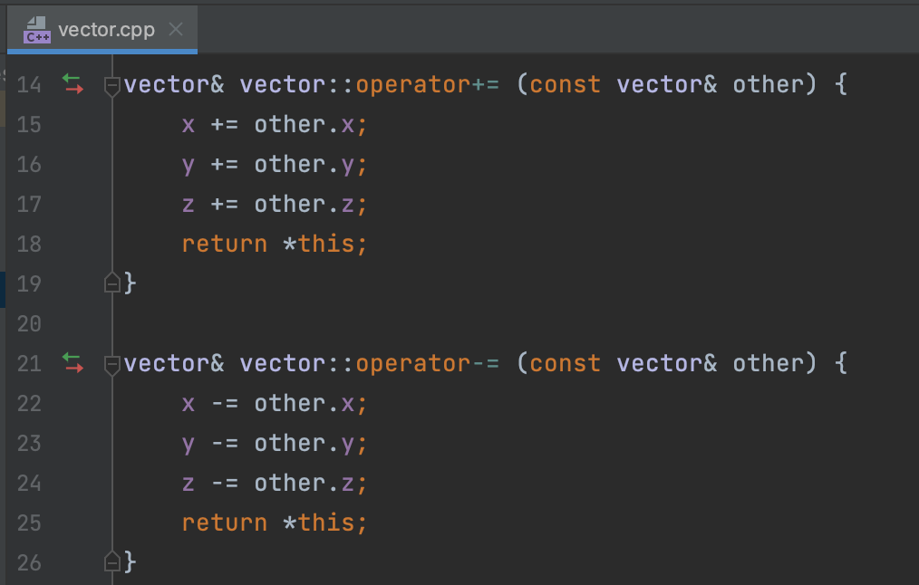
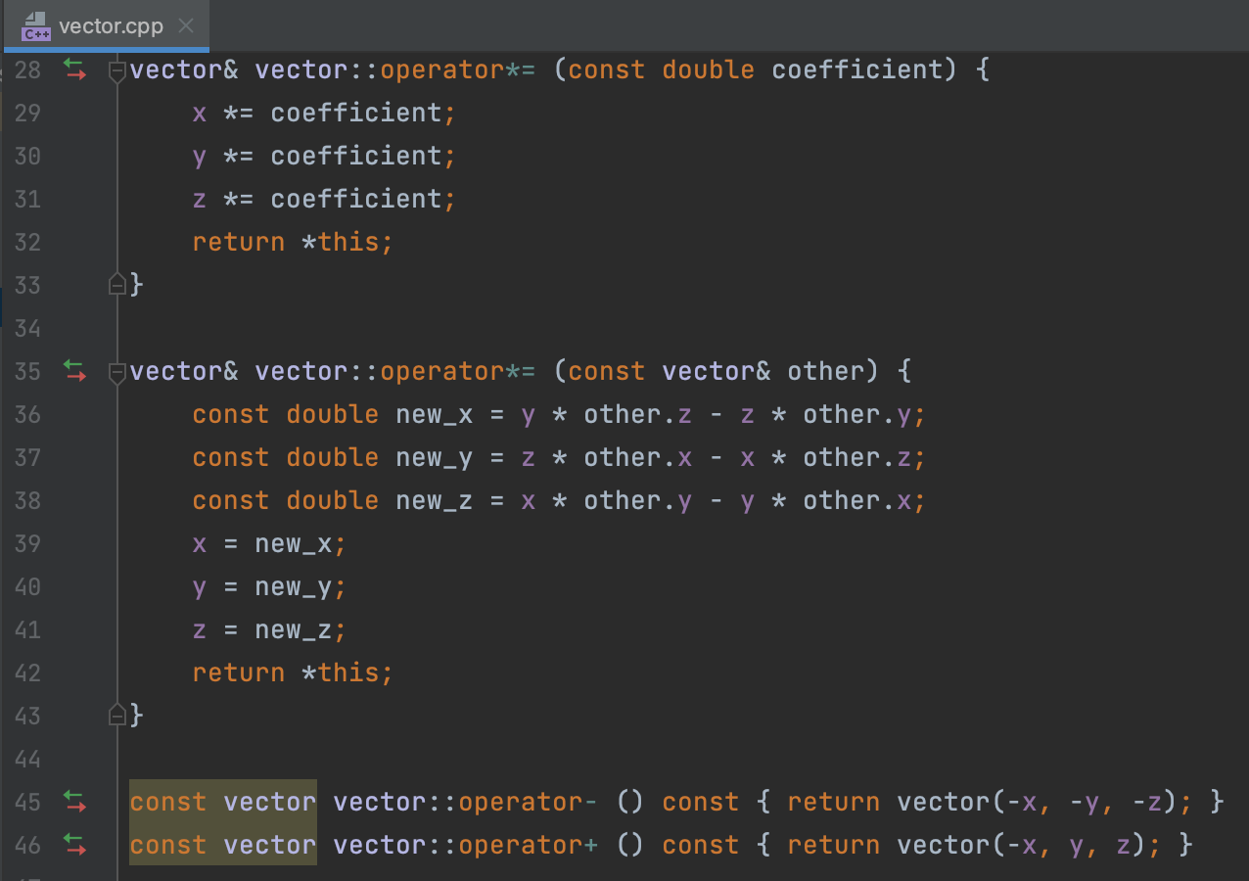
Splitting the solution into multiple files
Here’s some more definitions of several methods:

Slide 10
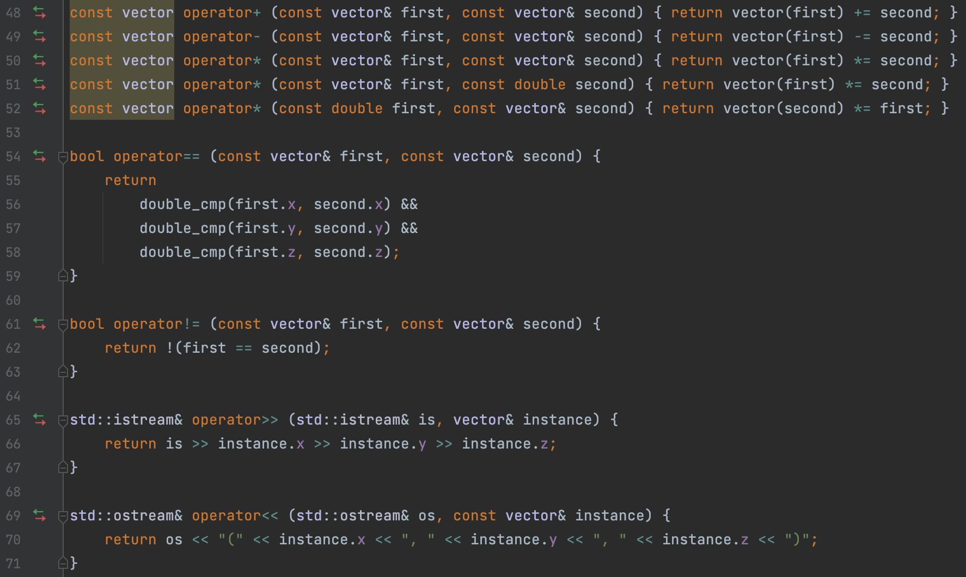
Splitting the solution into multiple files
And finally, the definition of ordinary functions.
By the way, note that in order to use the double_cmp function, we included file double_cmp.h in the vector.cpp file (but not in vector.h!)

Slide 11
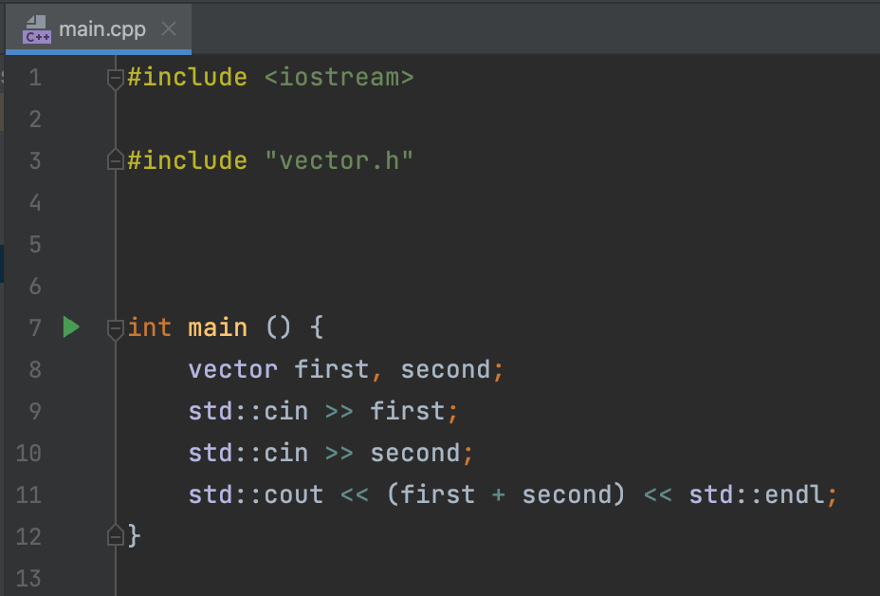
Splitting the solution into multiple files
To use our vector class in the main function, you need to include the corresponding header in the main.cpp file.

Slide 12
Splitting the solution into multiple files
Links to the full code:
CMakeLists.txt
double_cmp.h
double_cmp.cpp
vector.h
vector.cpp
main.cpp

Slide 13
Lecture 12
Classes and structures, pt.4
Konstantin Leladze
OOP in C++
DIHT MIPT 2021

